Slide 1

Futurense
2nd Stage
Company Project

Slide 2
Futurense
Futurense, is the Godfather of Talent, Our family comprises of three verticals which aims to bridge the gap between talent, their education, and their hunt for jobs.
➡ Futurense Campus - Aims to redefine the BTech degree
Practical learning with an up-to-date syllabus and industry-relevant skills—something that isn't happening with BTech in India currently.
➡ Futurense Uni - Aspirant’s 2nd chance to their IIT dream from the country's top IITs
➡ Futurense US Pathway - Historic Pathway to a US Master’s
With 65% scholarships, waiver on entrance exams, reduced course timelines, and a 3-year extended OPT

Slide 3
US Pathway
Data :
Campaign Performance
Leads Generated
Phone Metrics
Tokens Paid
Candidate Application Tracker

Slide 4

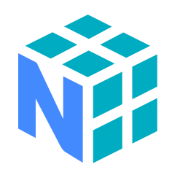


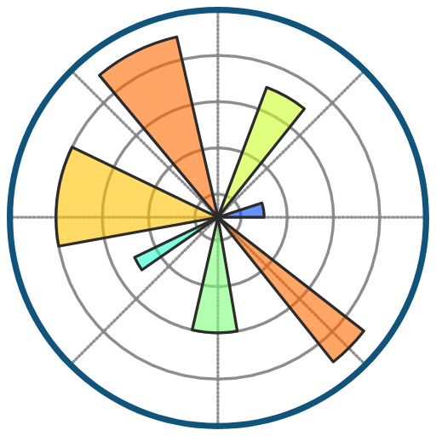

Tools
Python and its libraries
Power BI
SQL
Machine Learning

Slide 5
THANK YOU

